Slide 1
Familiarize yourself with phishing attacks
Human Resources
Marketing Services

Slide 2
What is phishing?
Phishing attacks are a type of online scam which uses emails or malicious websites to trick the recipient into providing personal information such as password, login id, account number, social security #, or other personal identification details.

Slide 3
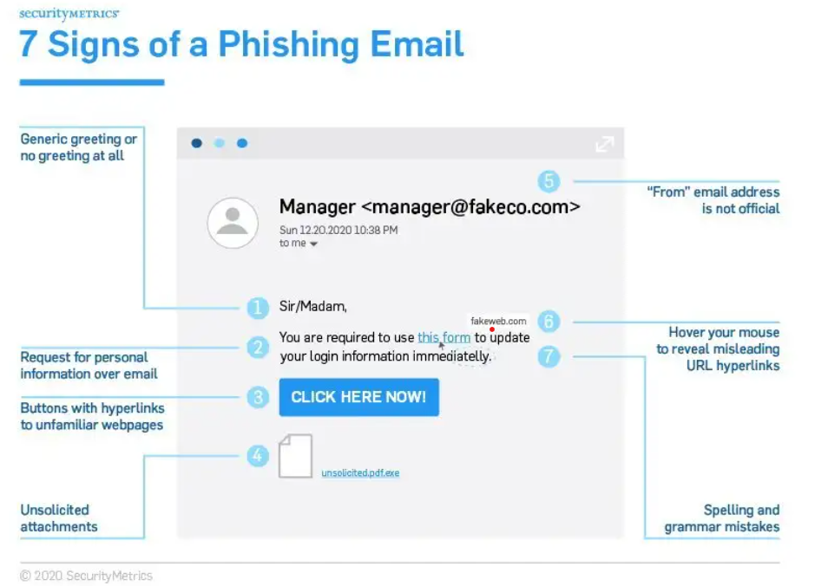
Learn to spot phishing emails
Common Indicators:
Suspicious sender's address. Look closely at domain name
Generic greetings and signature
Spoofed hyperlinks and websites. Hover over links.
Poor grammar, misspellings, inconsistent layout
Suspicious attachments: request ing download or opening
A sense of urgency

Slide 4
How do we stop getting phished?
➤ Consider every email suspicious. Examine each email closely.
➤ Never provide password over the phone or in response to an unsolicited internet request.
➤ Exercise caution when clicking on links. Hover over the link to check the URL.
➤ Avoid downloading attachments unless they are expected AND from a trusted source.
➤ If you are suspicious about an email confirm the sender actually sent it. Don't use information in the email to confirm it is a valid email.
➤ If an email looks suspicious, click the phish button in the upper-right hand corner to report it. Do Not click on any links or attachments. Delete the email.

